Slide 1


Type 1 Diabetes
Educational Event for Healthcare Professionals
Glinys Johnson - Diabetes Specialist Nurse (Independent) / DUK Clinical Champion
Gursharan Kaur- Health Systems Engagement Manager, Diabetes UK
Kiran Mahal - Health Systems Engagement Lead, Diabetes UK
Charlotte Austin – Type 1 Lead, Diabetes UK
Adam Mayze – Youth Co-Ordinator, Diabetes UK
Chris Parsons – Senior Project Manager, CVDR Network, Midlands Region

Slide 2
Type 1 Diabetes: Educational Event for Healthcare Professionals
Proportion of people registered with type 1 who received each care process, by ICB, 2022-23
ICB | Code | Type 1 Registrations | HbA1c (%) | Blood Pressure (%) | Cholesterol (%) | Serum Creatinine (%) | Urine Albumin (%) | Retinal Screening (%) | Foot Surveillance (%) | BMI (%) | Smoking (%) | All Eight Care Processes (%)
NHS Birmingham and Solihull ICB | QHL | 5,875 | 79.0 | 84.1 | 77.8 | 81.2 | 55.9 | 72.1 | 69.1 | 80.3 | 88.1 | 47.2
NHS Black Country ICB | QUA | 5,380 | 78.6 | 84.7 | 74.3 | 79.2 | 47.7 | 70.4 | 63.9 | 82.2 | 86.1 | 38.3
NHS Coventry and Warwickshire ICB | QWU | 4,210 | 79.7 | 84.4 | 72.4 | 78.8 | 42.2 | 76.5 | 66.3 | 77.4 | 87.6 | 33.5
NHS Derby and Derbyshire ICB | QJ2 | 5,590 | 85.7 | 86.2 | 77.8 | 83.4 | 55.8 | 81.6 | 68.8 | 81.4 | 89.0 | 44.4
NHS Herefordshire and Worcestershire ICB | QGH | 3,925 | 81.5 | 84.4 | 76.9 | 82.4 | 48.5 | 80.2 | 69.4 | 79.7 | 86.8 | 41.3
NHS Leicester Leicestershire and Rutland ICB | QK1 | 5,410 | 82.9 | 86.2 | 80.3 | 80.1 | 57.6 | 48.1 | 70.6 | 78.7 | 88.7 | 41.8
NHS Lincolnshire ICB | QJM | 3,950 | 85.2 | 88.3 | 81.5 | 85.6 | 48.9 | 79.8 | 71.0 | 81.5 | 88.6 | 40.9
NHS Northamptonshire ICB | QPM | 3,735 | 81.7 | 82.6 | 76.8 | 82.4 | 47.8 | 75.0 | 62.5 | 74.9 | 86.7 | 35.3
NHS Nottingham and Nottinghamshire ICB | QT1 | 5,825 | 83.1 | 88.4 | 74.6 | 80.6 | 46.6 | 79.5 | 66.6 | 82.1 | 87.3 | 37.7
NHS Shropshire Telford and Wrekin ICB | QOC | 2,495 | 83.4 | 83.4 | 73.5 | 79.4 | 43.9 | 76.5 | 54.2 | 74.8 | 85.1 | 30.1
NHS Staffordshire and Stoke-on-Trent ICB | QNC | 5,210 | 81.7 | 86.6 | 77.8 | 82.4 | 50.5 | 79.1 | 67.1 | 82.1 | 88.1 | 41.7
Midlands (ICBs summed) |  | 51,605 | 81.9 | 85.6 | 76.8 | 81.4 | 50.2 | 74.0 | 66.9 | 80.0 | 87.6 | 40.0
Source
NHS England, National Diabetes Audit, 2022-23

Slide 3
Type 1 and Technology
Charlotte Austin, Type 1 Lead @ Diabetes UK

Slide 4
Diabetes technology is an integral part of daily life for people living with type 1 diabetes, and it’s here to stay!

Slide 5

Why talk about tech?
Tech in numbers
• approx. 104,390 of people living with type 1 on non-invasive glucose monitoring (as per NDA and NPDA 21/22)
• approx. 35,489 of people living with type 1 on CSII (as per NDA and NPDA 21/22)
• 2,232 number of (children and young) people living with type 1 on hybrid closed loop systems (as per NDPA 21/22)
*these are approximate numbers based on England and Wales NPDA/NDA data and may not be precise due to overlaps, and differences between whether England and Wales are reported together or separately

Slide 6

What we did
The session structure
Overview of tech
1. Glucose monitoring
2. Insulin delivery
Automated systems
Policies and recommendations
1. NICE Hybrid Closed Loop Appraisal
Scenarios/practical learnings

Slide 7
Why use this approach
Sharing and learnings
Group work – communication
Different levels of experience
Variety of roles and knowledge
Feeding back learnings from all scenarios
Problem solving
Person-centred scenarios
Primary care-specific
Putting learnings into practice
An MDT approach is often needed

Slide 8
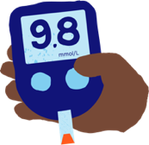

evaluation
35 delegates attended on the day of which 27 completed our assessment
Baseline assessment showcased that all those who attended regularly worked with people living with diabetes, but some had little to no education around type 1 diabetes
26 respondents strongly agreed/agreed that the topics covered were relevant and useful
Overall, increase in confidence with supporting and providing advice to those living with type 1 diabetes as well as an increase in awareness of specialist services

Slide 9



I pledge to improve diabetes care BY…
Be mindful of need for preconception care. Focus on this for people of childbearing age. Ensure optimised care provided and referral.
Check all type 1 patients able to test for Ketones and pump uses should have basal insulin /pens / test strips
Mental Health self-referral for people with LTC’s. F-to-F or online available
Screen in primary school to get early diagnosis to manage and signpost so will look at collaborative working
Search for Type 1’s and ensure Sick Day Rules are issued

Slide 10

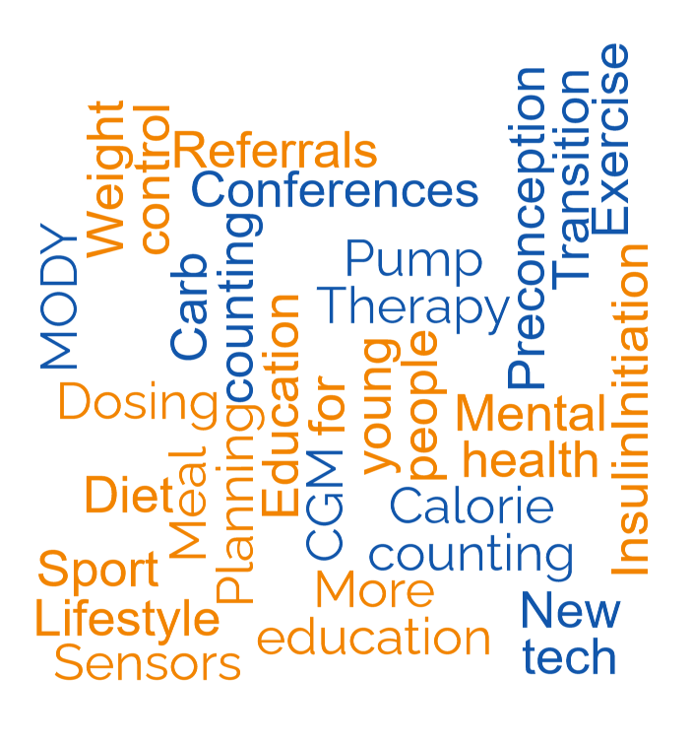

Future topics
Programme can be tailored depending on local need.
Some of the topics attendees thought would be useful for future events:
  Meal planning
  Mental Health
  Preconception
  CGM
  Calorie/carb counting

Slide 11
Type 1 Diabetes: Educational Event for Healthcare Professionals
Benefits
Increasing confidence across HCPs in supporting and signposting patients to ensure the best care possible
Better outcomes for T1D patients
Increase in Treatment Targets and Care Process results
Free educational packs from DUK for all attendees
Lived experience presentations
No cost implications to ICB

Slide 12
Type 1 Diabetes: Educational Event for Healthcare Professionals
Next steps
Follow up pledges after 6 months to check in with progress and celebrate success
To run this across every ICB over the next 12 months
  Prioritising from NDA where the greatest need is
  But also happy to work with ICB’s who keen to run this ASAP
We already have a great agenda that can be tweaked to suit local needs
Glinys, DUK and regional colleagues will support the delivery – we just need local ICB support to promote and identify a local clinician or two who can support on the day
Contact us to discuss further:
glinys.johnson@nhs.net
chris.parsons3@nhs.net
charlotte.austin@diabetes.org.uk
adam.mayze@diabetes.org.uk
kiran.mahal@diabetes.org.uk

Slide 13
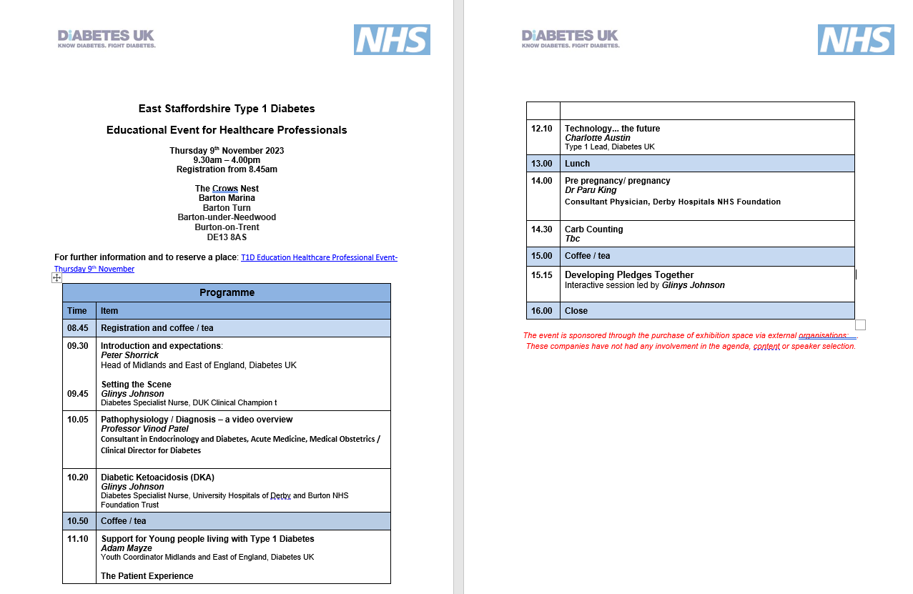
Type 1 Diabetes: Educational Event for Healthcare Professionals – Agenda

