Slide 1
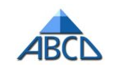
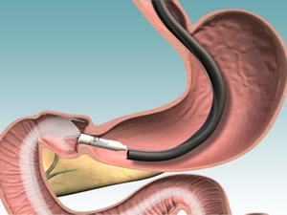




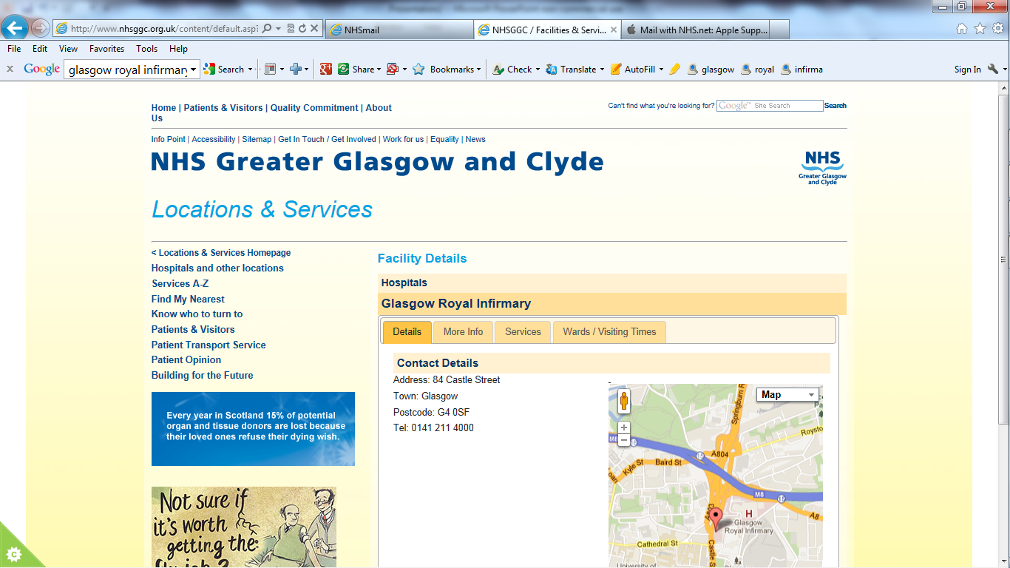
Endoscopic proximal intestinal exclusion can improve non-alcoholic fatty liver disease (NAFLD) in patients with diabesity
Bu’Hussain Hayee
on behalf of the REVISE-Diabesity Investigators
King’s College Hospital, London
Digestive Diseases Week
24th May 2016
Notes:
V2 – 20May2016 CONFIDENTIAL

Slide 2
Background
Twin pandemics of diabesity and NAFLD unabated
Weight loss is an effective treatment for both
Limited effective weight loss interventions
    GLP-1RAs can be effective, but 75% of patients fail to meet NICE criteria for continuation of therapy¹
    < 10-15% eligible patients ever come to surgery
New effective therapies are urgently needed
Thong KY, Sen Gupta P et al. Br J Diabetes 2014.14:52-59

Slide 3
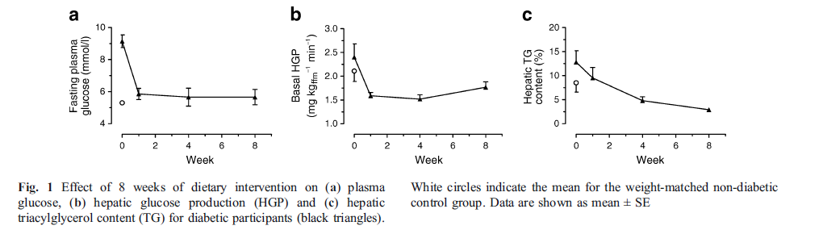
Proof of Principle: Newcastle Diabetes Diet Study
8-week 600kCal dietary intervention reverses diabetes
n11 new onset type 2 diabetes (n8 age-, sex-, weight-matched non-diabetic subjects)
Liver triacylglycerol content measured using three-point Dixon MRI
Lim EL, Hollingsworth KG et al. Diabetologia 2011. 54(10):2506-14
Notes:
Fasting plasma glucose normalised at 1 week (9.2± 0.4 to 5.9±0.4 mmol/l; p=0.003)
Hepatic triacylglycerol content decreased by 30±5% at week 1 (p<0.001) becoming similar to control values (p=0.75), 70±5% at week 8
weight -15 kg, waist -13.2 cm, HbA1c -1.4% (7.4% to 6.0%)
Proof of concept that hypocaloric diet:
Decreased liver fat with normalisation of hepatic insulin sensitivity
Decreased pancreatic fat with normalisation of beta cell function

Slide 4
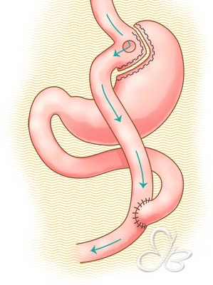

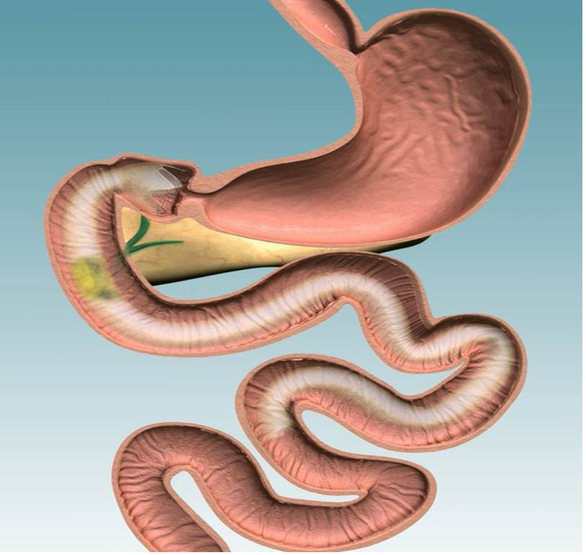
Endobarrier – implantable duodenal-jejunal liner
Fluoropolymer
wall
Nitinol Anchor
60 cm impermeable sleeve
Minimally invasive
Roux-en-Y gastric bypass surgery
Notes:
The Endobarrier device is something that we’ve explored in the UK. This schematic compares the Endobarrier device to Roux-en-Y gastric bypass. The EB as many of you know, is an implantable intestinal liner which excludes the duodenum and proximal jejunum up to a total length of 60cm – preventing bile from mixing with chime as well as chime from interacting with the mucosal surface only in this part of the intestine. It is therefore demonstrably – at least primarily – not a malabsorptive procedure

Slide 5
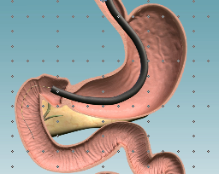
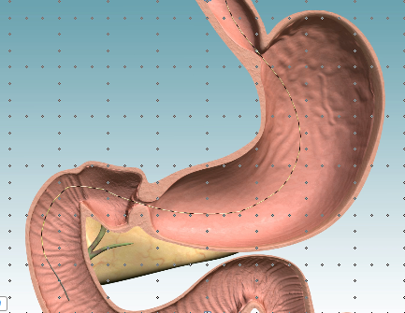

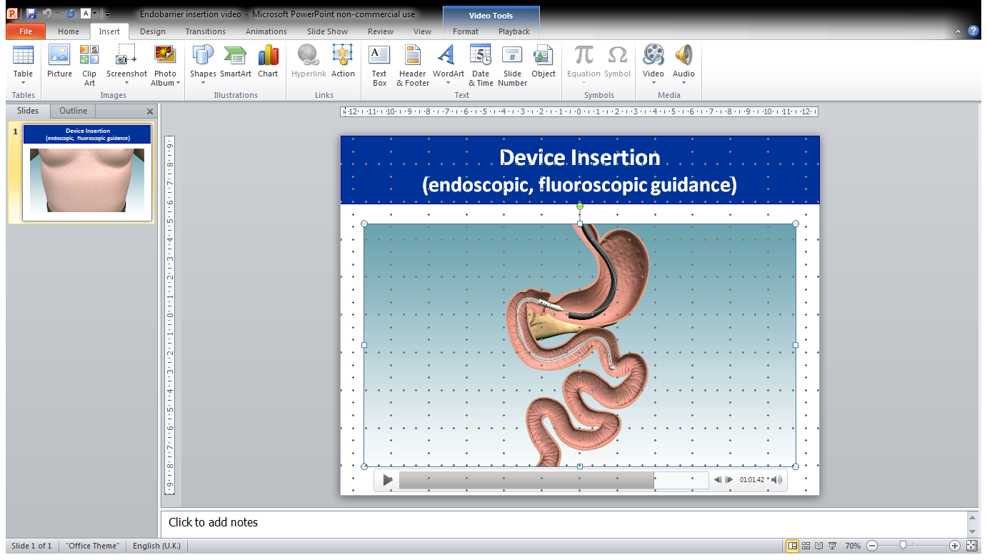
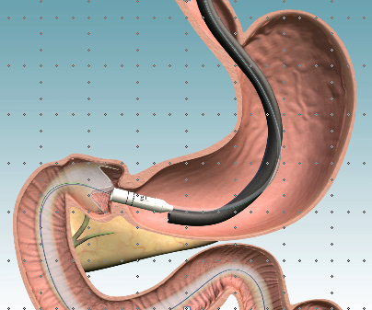
Endobarrier placement is a day-case procedure
Endoscopy
Guidewire
left in-situ
Capsule
delivery
Endobarrier
deployment
Crown anchor
release
F
Endoscopic (< 20 mins)
Fluoroscopy (< 45 secs)
GA, day case
Implant for 1 year
Reversible
2-week diet post

Slide 6

Open label, multicentre, parallel group, randomised controlled trial
Trial Registrations:
ISRCTN00151053
NCTNCT02055014
R

Slide 7
Study design: Selection Criteria
INCLUSION CRITERIA:
Type 2 diabetes
Liraglutide treated ≥6 months
HbA1c ≥58mmol/mol (7.5%)
Obesity, BMI ≥35kg/m²
Stable weight, HbA1c ≥ 3 months
EXCLUSION CRITERIA:
Safety considerations:
Bleeding risk: aspirin, warfarin
Infection
Pregnancy
Conditions interfering with Endobarrier placement/findings
R

Slide 8
Study design:
Open label, multicentre, parallel group, randomised controlled trial
Endobarrier+liraglutide 1.2mg
liraglutide 1.2mg
2-wk
liquid puree
diet
R
Endobarrier, no liraglutide
no liraglutide
liraglutide 1.8mg
liraglutide 1.8mg
Year 1
Year 2
Treatment start endobarrier explant Treatment end
Visit
Schedule
Base M1 M3 M6 M9 M12 M15 M18 M21 M24
  3-monthly visits: interview, anthropometry, blood tests (fbc, u&e, lft, amylase, lipids, HbA1c)
  Primary outcome: HbA1c at 2 years
  Subgroup MRI liver and pancreas – baseline and 4 months

Slide 9
Sub-study aim
To investigate the impact of endoscopic proximal intestinal exclusion, with or without additional glucagon-like peptide-1 receptor agonist (GLP-1RA) on NAFLD

Slide 10
Summary
NAFLD Fibrosis Score (NFS)
Parameters
Age
BMI
Diabetes status
ALT: AST
Platelets
Albumin
Calculation
= -1.675 + 0.037 × age (years) + 0.094 × BMI (kg/m²) + 1.13 × diabetes status (yes = 1, no = 0) + 0.99 × AST/ALT ratio - 0.013 × platelet count (×10⁹/L) - 0.66 × albumin (g/dL)
NFS
< -1.455 = low risk
-1.455 to 0.675 = indeterminate
>0.675 high risk
Notes:
ANOVA Qrisk 0.7, UKPDS 0.10

Slide 11
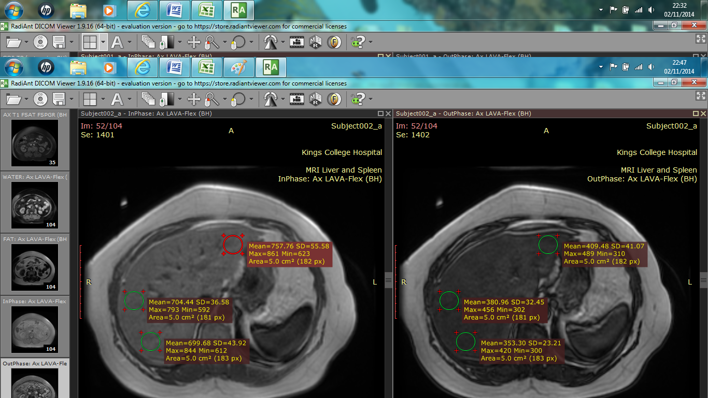
MRI fat fraction
Subgroup of n=8 from Endobarrier-treated group at KCH
Images separated into in-phase/out-of-phase
3 independent, blinded assessors
Selected 3 regions of interest (ROI)
  5cm² area
  anatomically pre-defined
  Reduced error due to focal change
Standard uptake values
Liver-fat fraction calculation:
η=[S_IP-S_OP]/(2×S_IP )
(IP = in-phase signal, OP = out-of-phase signal)
Notes:
Assessors –blinded – to treatment group and to whether it was a before or after scan we were assessing
3ROIs to minimise errors due to focal changes

Slide 12
Flowsheet of study subjects (n70)
Assessed for eligibility (n=195)
Excluded (n=110)
Did not meet inclusion criteria (n= 54)
Had exclusion criteria (n=38)
Declined to participate (n= 11)
Other (n7)
Excluded after randomisation (n=15)
Wanted specific allocation only (n=13)
Emigrated (n1)
Unrelated SAE (n1)
n70
TREATMENT
GROUP
Endobarrier + liraglutide
Endobarrier
Liraglutide 1.8mg
n
24
24
22
Intention to treat analysis

Slide 13
Baseline characteristics
Parameter | Endobarrier +liraglutide N=24 | Endobarrier N=24 | Liraglutide N=22
Age (years) | 52.0±11.7 | 50.7±8.4 | 54.0±10.1
Sex (% male) | 41.7 | 29.2 | 36.4
Ethnicity (% Caucasian) | 66.7 | 70.8 | 72.7
*Diabetes duration (yrs) | 11.2 (6.7-17.1) | 10.3 (7.8-12.7) | 13.3 (9.0-18.4)
Taking insulin (%) | 58.3 | 25.0 | 45.5
BMI (kg/m²) | 40.3±4.8 | 41.7±4.9 | 40.6±4.4
Weight (kg) | 112.8±20.4 | 115.6±19.4 | 113.9±14.9
HbA1c (%) | 9.6±1.4 | 9.3±1.7 | 9.7±1.7
NFS (% high risk) | 33.3 | 34.7 | 20.0
*medican(interquartile range) No significant differences between groups
Notes:
Chi2 NFS P=0.51

Slide 14
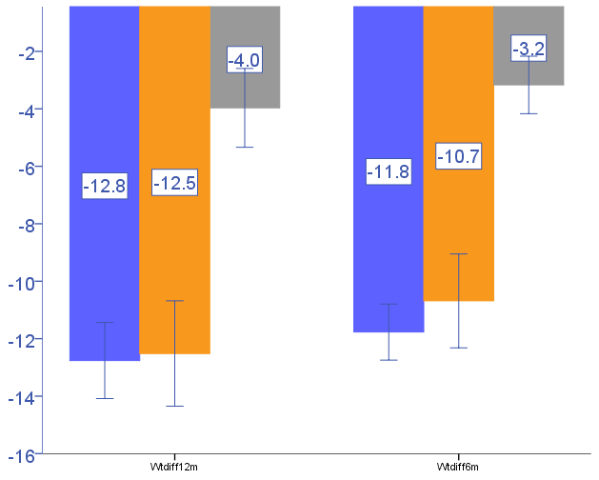
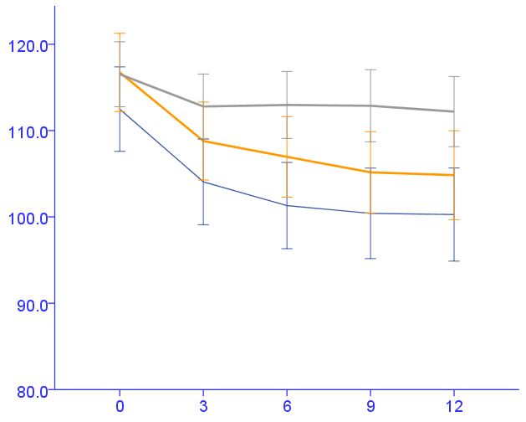
TBW
Weight (Kg) mean
± 1SE
E+L
E
L
Weight loss at 1yr vs base
**
***
***P<0.0001, **P<0.001
Time since treatment (months)
Notes:
ANOVA between groups: Wt diff_3m, 6m, 9m, 12m P<0.0001; independent t-test: 1vs2 P=0.65
Paired t-test for base to 12m group1: P<0.0001, 2: P<0.0001, 3: P=0.07
L1.8mg 4.0kg reduction similar to published trials

Slide 15
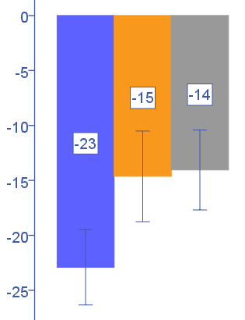
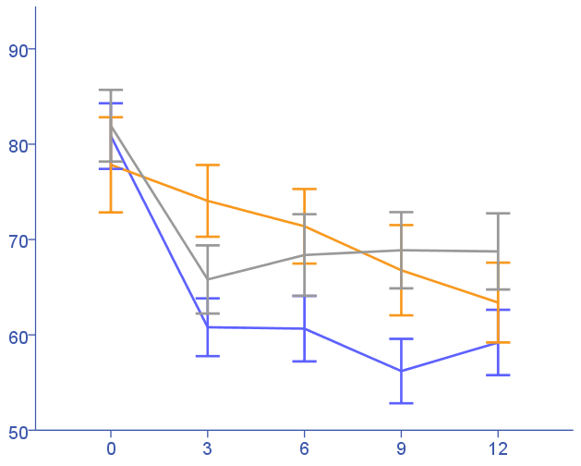
HbA1C
HbA1c mean± 1SE
% mmol/mol
E+L
E
L
HbA1c reduction at 1yr vs base
10.0
9.0
8.0
7.0
-2.1%
-1.2%
-1.3%
P=0.07
P=0.06
Time since treatment (months)
Notes:
ANOVA between groups: A1c diff_3m, P=0.001, 6m P=0.01, 9m P=0.023, 12m P=0.097 (1vs2: P=0.066, 2vs3: 1vs3=0.059)
Paired t-test for base to 12m group1: P<0.0001, 2: P=0.001, 3: P<0.001
9months (1vs2 P=0.018, P, 1vs3 P=0.03, 2vs3 P=0.74)

Slide 16
NFS change over time
Baseline
3 months
E+L
E
L
Notes:
Updated (ALL) base n20/67=29.9% high risk, 3m: n10/64=15.6% high risk, 12m: n13/64=20.3%
ALL@Base: lowrisk=10.5%, [indet=59.7%], highrisk=29.9%
GroupE+L
GroupE
GroupL

Slide 17
Summary
Impact of treatment on NAFLD fibrosis score
P=0.001
P=0.002
Notes:
Remember lower the NFS, lower the risk
Paired t-test 3m liraglutide P=0.37; 12m E+L P=0.12, E P=0.10, L P=0.86
ANOVA 3m P=0.44, 12m P=0.48
Independent t-tests @3m group 1vs2 P=0.51, 1vs3 P=0.48, 2vs3 P=0.23
@12m 1vs2 P=0.48, 1vs3 P=0.55, 2vs3 P=0.28

Slide 18
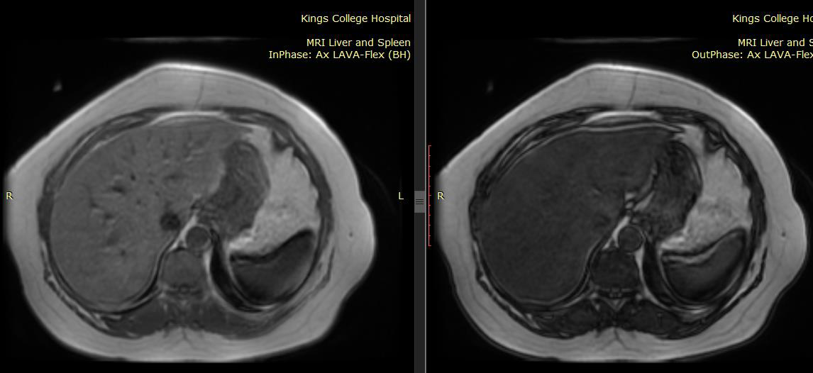
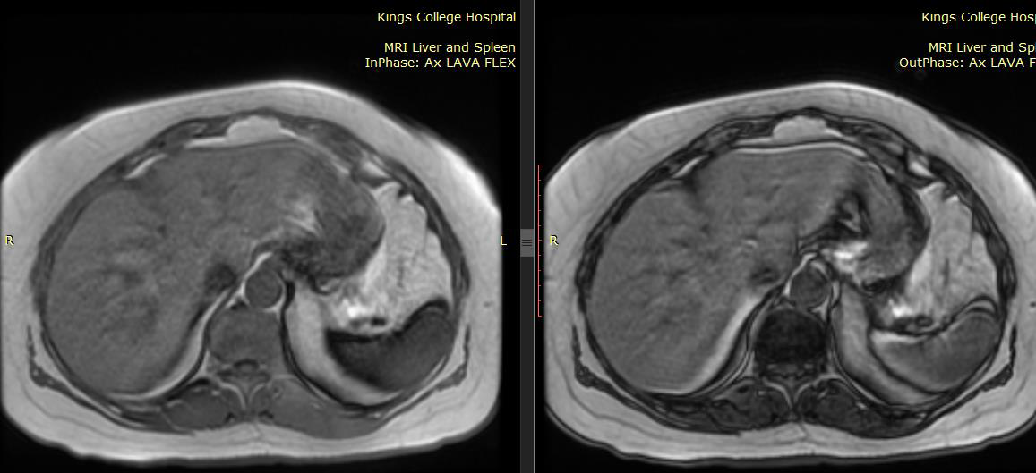
Summary
Liver fat pre- and post-MR images
In-Phase
Out of phase
Baseline
Fat fraction 22.4%
4-months
post-Endobarrier
Fat fraction 0.5%
Notes:
Representative axial MRI of the liver. A&B are the separated in-phase and out-of phase images.
C&D are the equivalent images. Right image appears darker (loss of signal compared to left image – suggesting high intrinsic fat content.
In comparison, little alteration between in phase and out of phase images after endobarrier suggesting a lower fat content.
This was reflected in the actual standard uptake values such that calculated hepatic fat was 22.4% baseline, 0.5% post endobarrier.

Slide 19
Summary
MRI analysis
Mean hepatic fat fraction
  14.9 ± 9.4% to 2.9 ± 4.5%, p=0.003
Mean pancreatic fat fraction
  6.9% to 1.3% post-endobarrier, p=0.02

Slide 20
Safety Data
Table of Serious Adverse Events (related)
 | Endobarrier +liraglutide | Endobarrier | Liraglutide
Gastrointestinal symptoms resulting in early removal | 3 | 2 | ---
Symptomatic cholelithiasis | --- | 2 | ---
GI Bleed | --- | 1 | ---
Obstruction | 1 | 1 | ---
Complicated removal | --- | 1 | ---
Liver abscess | --- | 2 | ---
5/48 (10.4%) cases had serious complications and all had a full recovery following endobarrier removal
Notes:
GI symptoms common after procedure – mostly nausea/ upper gi discomfort. We have listed 5 cases in which there were early removals due to GI symptoms – a mixture of nausea, bloating, abdominal pain. Removed at 1.4, 3.8, 6.6, 8.7 and 10.1 months; 3 from the E+L group; 2 cases were from the E group.
Symptomatic cholelithiasis: There were 2 cases of cholecystitis – 1 at around 10 months in the E group – the endobarrier was removed early at 10.3 months but she has not since undergone any gallbladder surgery. The 2nd case occurred 4 days after removal of the endobarrier and the patient went on to have elective laparoscopic cholecystectomy 4 months later.
There was 1 gastrointestinal bleed this occurred 8 weeks after implant – presenting with haematemesis. Hb to 85g/l.
There were 2 cases of obstruction – both just after the 6-month visit. Both had the device removed and 1 had a complicated removal, requiring the need for open pharyngectomy.
There were 2 cases of liver abscess – 1 which presented within 2 months of implant.
The 2nd case occurred in a patient that had the longest implant duration in our trial at just over 16 months – 4 months beyond the planned removal time.

Slide 21
Summary
Summary
Both Endobarrier groups produced reduction in:
- weight
- liver fat
- pancreatic fat
E+L group demonstrated a trend towards superiority with HbA1c reduction at 1-year, achieved with reduction in other diabetes medication

Slide 22
Conclusion
Proximal intestinal exclusion with Endobarrier reduces liver fat fraction, even in patients with suboptimal response to GLP1-RA therapy

Slide 23
Acknowledgements
All study participants
KITE: Louise Bensaid, Ross Carter, David Galloway, Lesley Sadler
Research Nurses/ CRF facility: Alison Begg, Elka Giemza, Manju Joy, Fiona Kinney, Fran Lloyd, Hilary Peddie, Louisa Green, Noah Yogo
Fellows: Ramdeep Bajwa, Siang Lee, Sebastian Lugg, Lois Murray
Administration: Rosa DaCosta, Vikram Johal, Ben Stothard, Melanie Wyres
R&D: Jocelyn Bell
Statistician: Andrew Blann
Data monitoring committee: Cliff Bailey, John McClure, Parth Narendran
Association of British Clinical Diabetologists
NIHR / Wellcome Trust
King’s Clinical Research Facility

