Slide 1

Supporting people living with diabetes to achieve better outcomes: Impact of the ABCD audit programme
Dr Bob Ryder and Dr Emma Wilmot
Diabetes UK Professional Conference 2023
Exhibition Centre Liverpool
April 26, 2023

Slide 2
Disclosures
Dr Bob Ryder has received speaker fees, and/or consultancy fees and/or educational sponsorships from Abbott, BioQuest, GI Dynamics and Novo Nordisk
Dr Emma Wilmot has recieved research support from: Abbott, Insulet, Novo Nordisk, Sanofi. Personal fees from: Abbott, Dexcom, Eli Lilly, Embecta, Insulet, Medtronic, Novo Nordisk, Roche, Sanofi, Ypsomed.

Slide 3
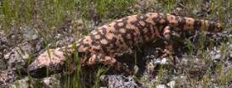
ABCD audits update
Dr Bob Ryder
ABCD Meeting, NEC, Birmingham
September 8, 2022

Slide 4
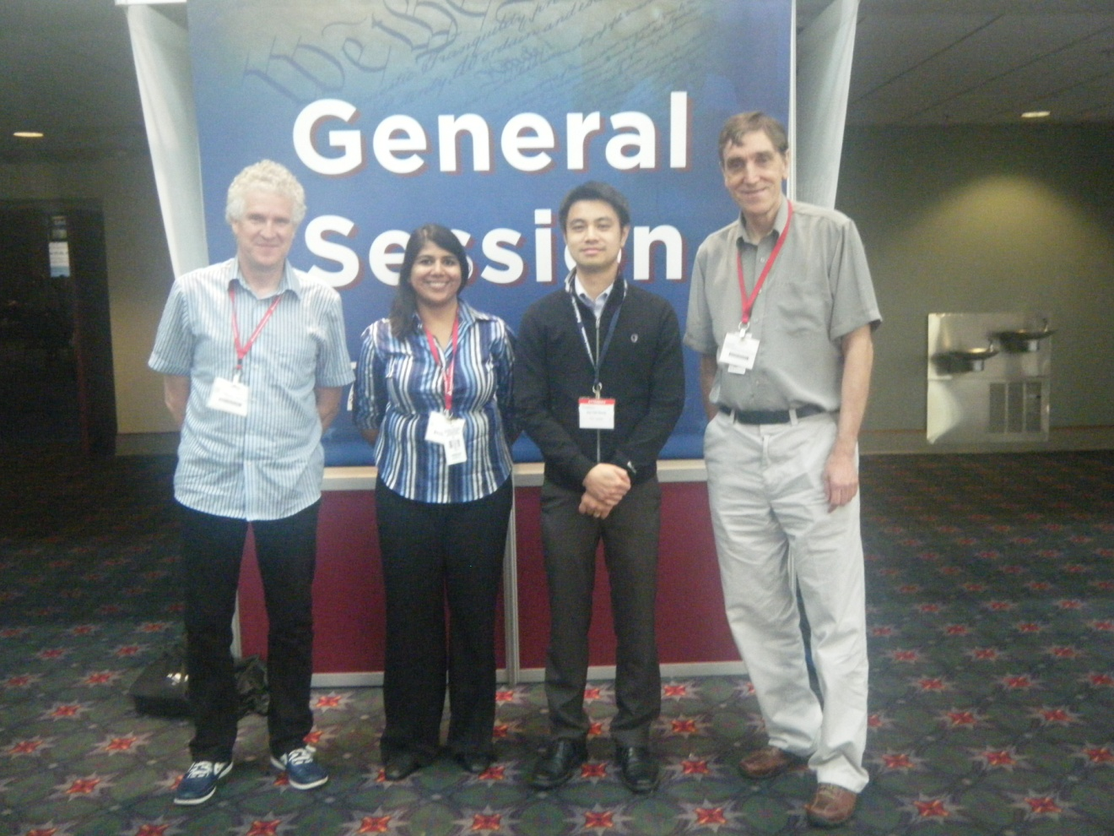
Dr Bob Ryder
ABCD Clinical Lead
Dr Piya Sen Gupta
ABCD Research Fellow
Dr Ken Thong
ABCD Research Fellow
Dr Chris Walton
ABCD Chairman 20011-2014
ABCD Nationwide Exenatide and Liraglutide Audits
Notes:
Melissa – database administrator

Slide 5
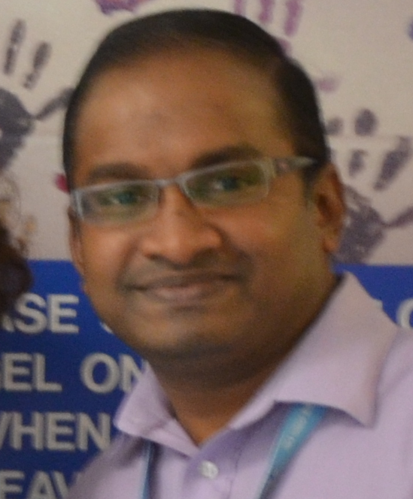

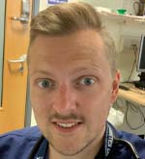
Dr Mahi Yadagiri
ABCD Research Fellow
Dr Harshal Deshmukh
ABCD Research Fellow
Dr Tom Crabtree
ABCD Research Fellow
Dr Piya Sen Gupta
ABCD Research Fellow
Dr Ken Thong
ABCD Research Fellow
ABCD Nationwide and Worldwide Audits
Notes:
Melissa – database administrator

Slide 6
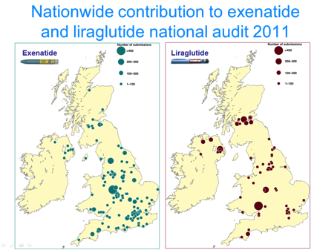
ABCD nationwide exenatide and liraglutide audits
Real-life data
  >13000 patients from
  >150 centres
  >500 contributors
There have been
  14 published papers
  24 abstracts
  13 oral presentations
https://abcd.care/abcd-nationwide-exenatide-audit-publications
https://abcd.care/abcd-nationwide-liraglutide-audit-publications

Slide 7
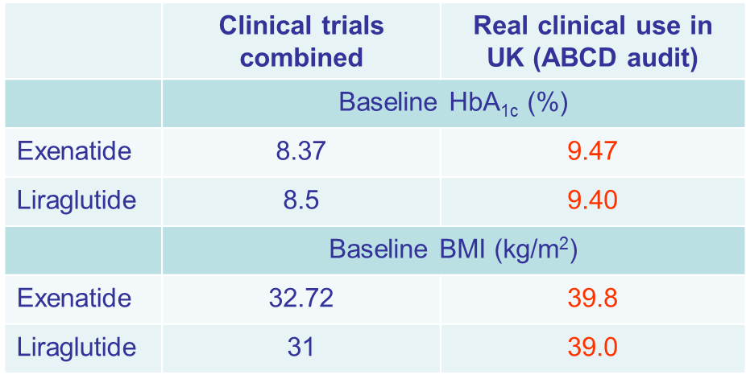
Combined trials vs real world
Real world patients more poorly controlled and heavier than in the clinical trials
Nevertheless the agents have proven to be very effective

Slide 8
Combined trials vs real world
Real world patients more poorly controlled and heavier than in the clinical trials
Nevertheless the agents have proven to be very effective

Slide 9
Combined trials vs real world
Real world patients more poorly controlled and heavier than in the clinical trials
Nevertheless the agents have proven to be very effective

Slide 10
Combined trials vs real world
Real world patients more poorly controlled and heavier than in the clinical trials
Nevertheless the agents have proven to be very effective
We have found this phenomenon in ALL our audits of:
  GLP-1 receptor agonists
  SGLT2 inhibitors

Slide 11
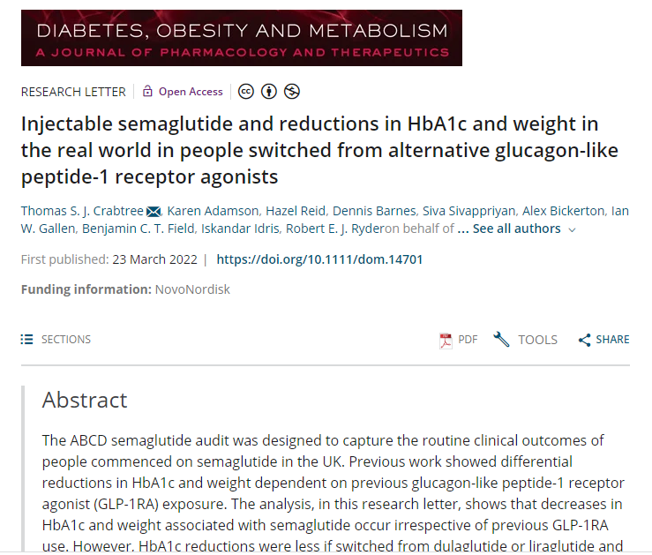
ABCD nationwide semaglutide audit
Patients heavier and more poorly controlled than in the clinical trials
Considerable reductions in weight and HbA1c
Those switched to semaglutide from other GLP1-RAs demonstrated significant additional reductions in HbA1c and weight after making the switch

Slide 12
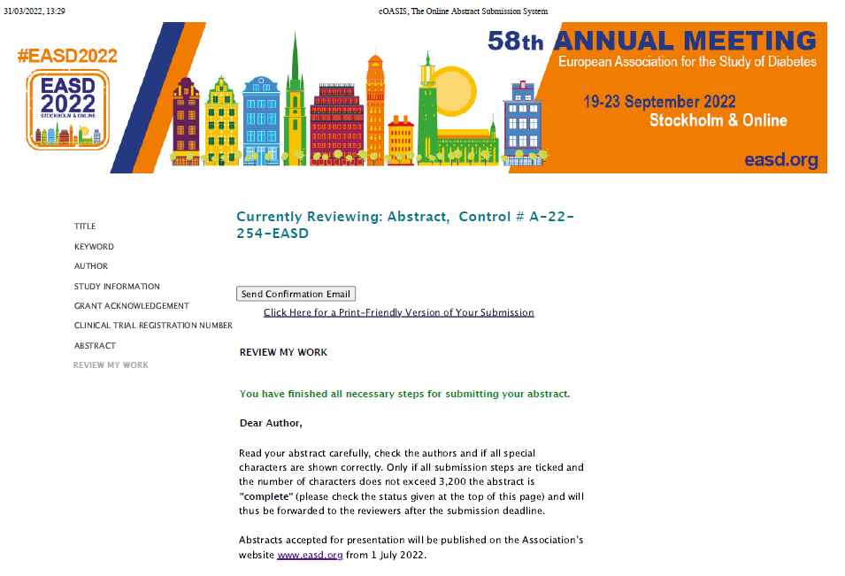
ABCD nationwide semaglutide audit
HbA1c and weight changes with semaglutide at 6- and 12-months post commencement: updated results from the ABCD semaglutide audit
HbA1c reductions associated with semaglutide observed in the first 6-months persist at one year
Weight continues to be lost beyond the initial 6-month period

Slide 13
Supporting people living with diabetes to achieve better outcomes: Impact of the ABCD audit programme
Dr Bob Ryder and Dr Emma Wilmott
Diabetes UK Professional Conference 2023
Exhibition Centre Liverpool
April 26, 2023

Slide 14
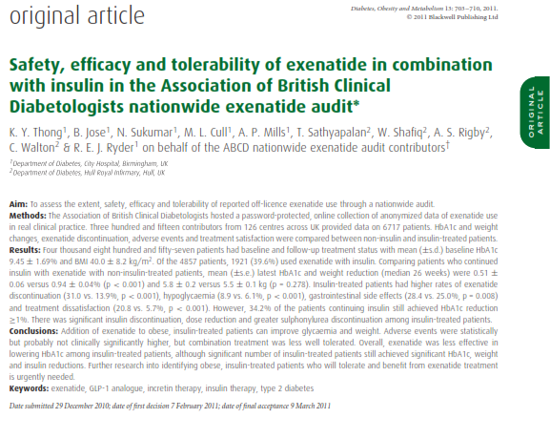
Exenatide audit: off licence use with insulin
Off licence exenatide with insulin safe and effective in real clinical practice
Reduction in insulin dose frequently occurred
Weight fell
1 in 6 patients came off insulin
Thong et al. Diabetes, Obesity and Metabolism 2011; 13(8): 703-710

Slide 15
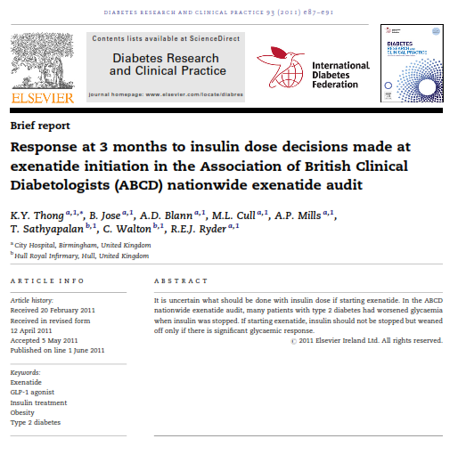
Exenatide audit: important safety issue uncovered
Some clinicians attempted to stop insulin when starting exenatide in order to stay within guidelines
This led to harm in some patients
Seven cases of diabetic ketoacidosis in patients who stopped insulin at the time of exenatide initiation
Analysis of audit data allowed us to recommend that when starting a GLP1-RA in an insulin-treated patient not to stop the insulin but rather to tail the insulin off during treatment if response to treatment allowed
Thong et al. Diabetes Res Clin Pract. 2011; 93(2): e87-e91

Slide 16
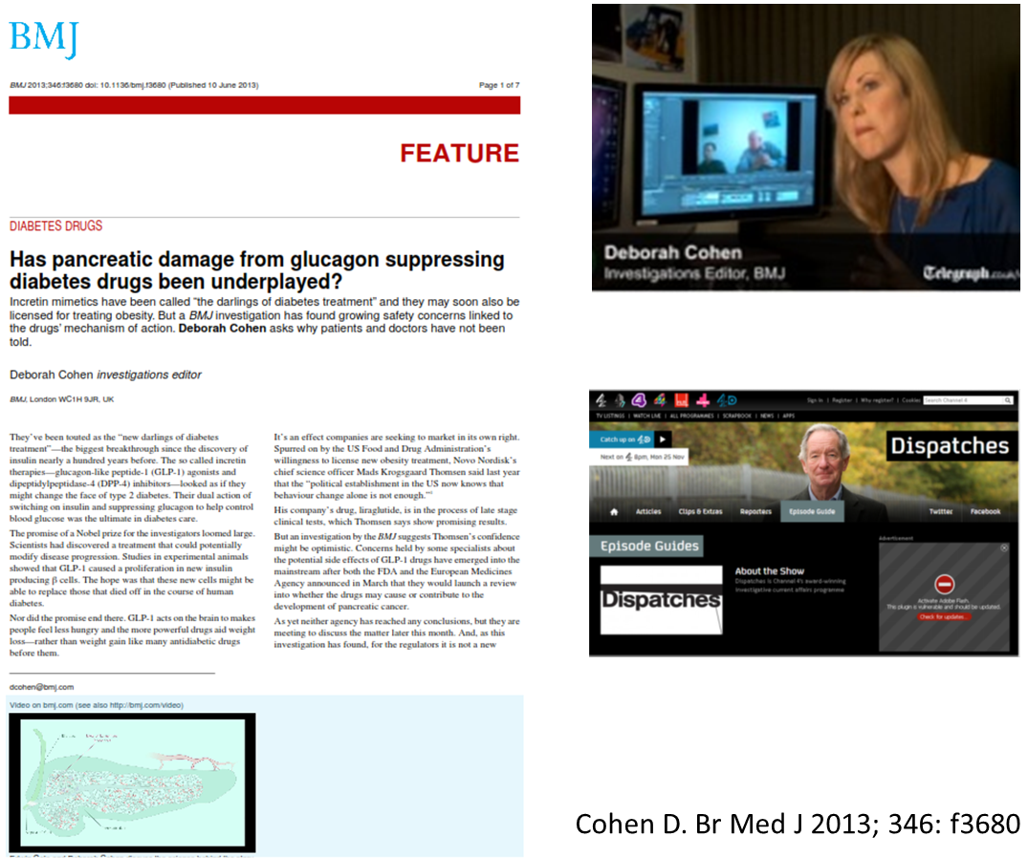
ABCD audit data allowed us to re-assure about pancreatitis
Alarm raised (BMJ and Channel 4 Dispatches TV programme) in 2013 that incretin therapies might cause pancreatic damage
We have been able to contribute by publishing data suggesting that in the ABCD audits there is no evidence of such a side effect:

Slide 17
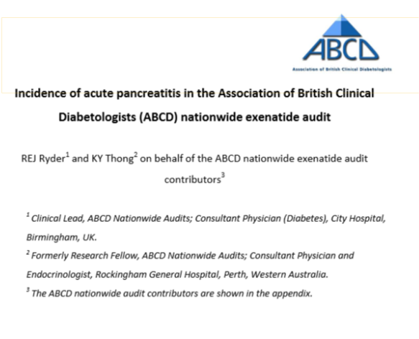
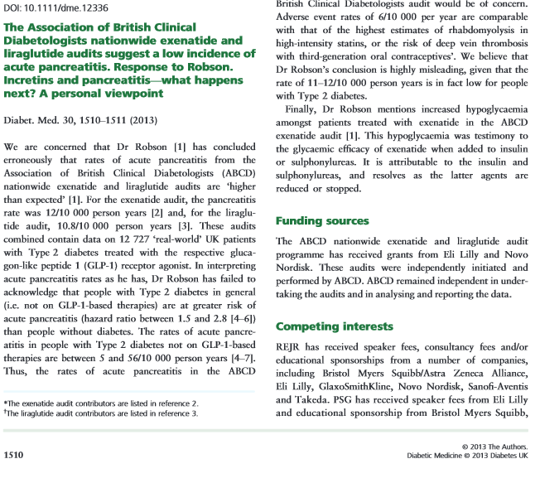
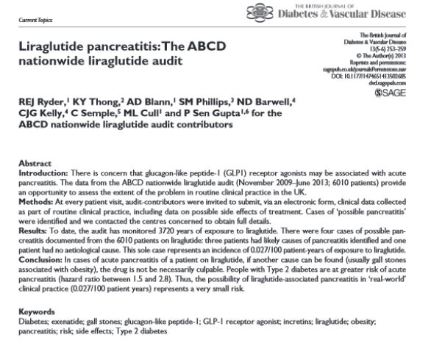
ABCD audit data allowed us to re-assure about pancreatitis
Rates of acute pancreatitis in the ABCD exenatide and liraglutide audits were at the low end of the rates expected for people with type 2 diabetes in general
75% of the cases of acute pancreatitis in the ABCD exenatide and liraglutide audits had other causes for acute pancreatitis, in particular gall bladder disease

Slide 18
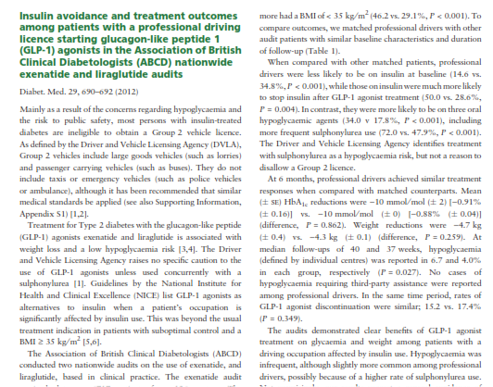
GLP1-RAs in professional drivers
Many patients with a professional drivers licence who would lose their jobs if they went onto insulin, were able to avoid insulin, and maintain similar glycaemic outcomes and keep their jobs by using exenatide or liraglutide
Thong et al. Diabetic Medicine 2012; 29(5): 690-692

Slide 19
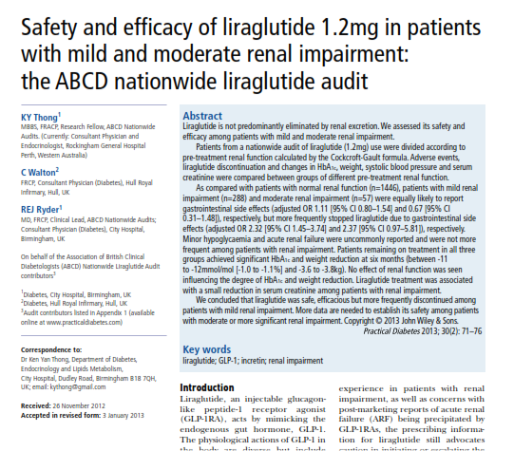
Liraglutide in renal impairment
Liraglutide was safe and effective among patients with moderate renal impairment, which had been an exclusion for use
Thong et al. Practical Diabetes 2013; 30(2): 71-76

Slide 20
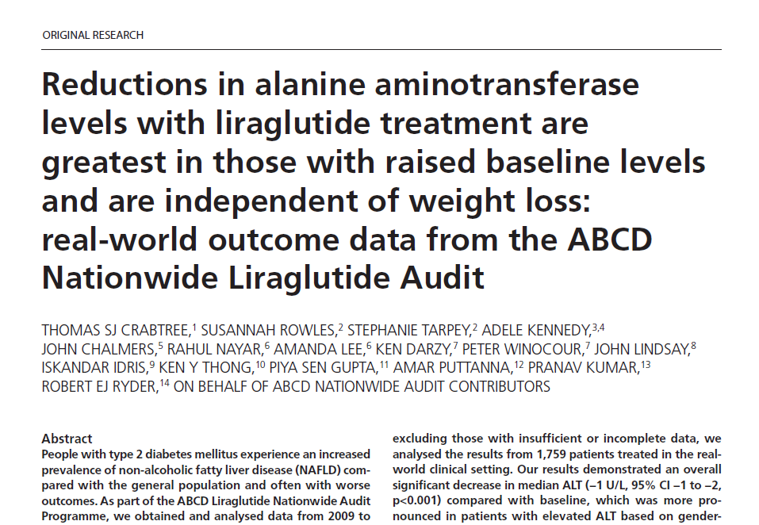
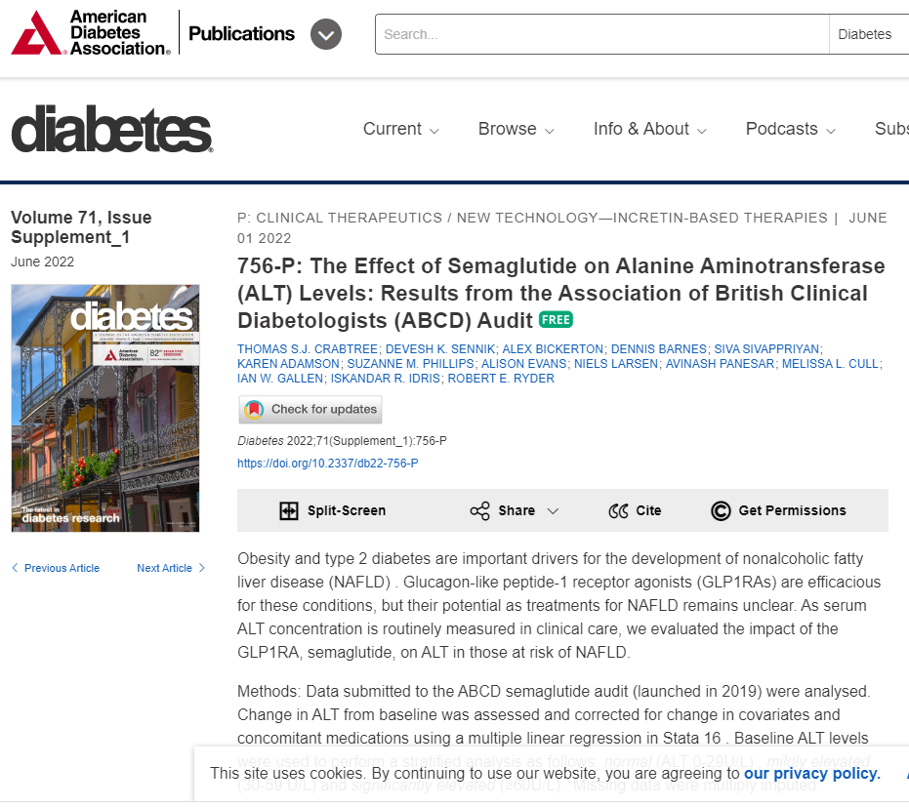
Diabetes and NAFLD – impact of GLP-1 RA on ALT
Among patients with raised ALT, liraglutide and semaglutide associated with ALT reduction

Slide 21
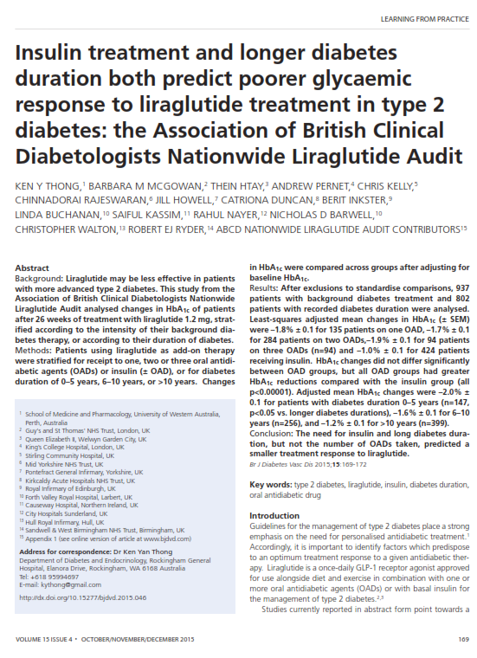
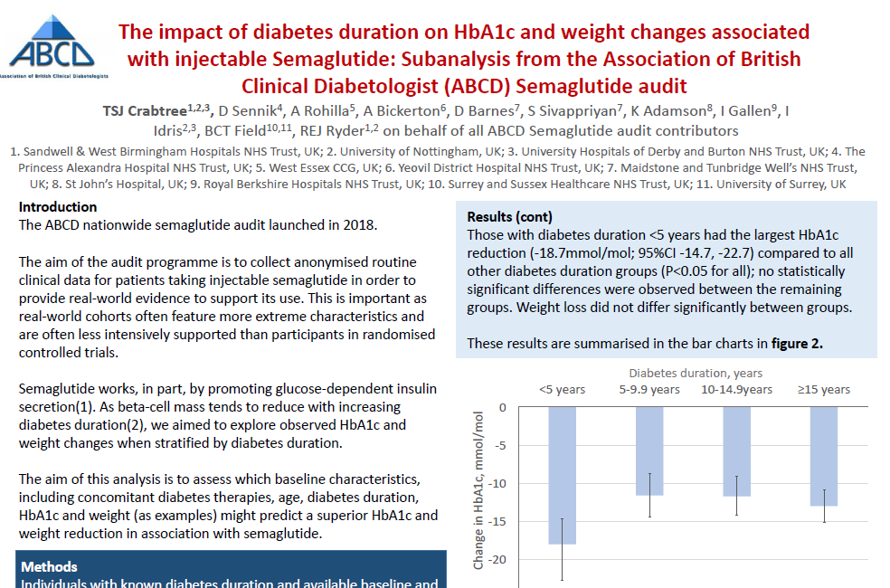
GLP1-RA – predicting treatment response
Liraglutide and semaglutide associated associated with greater HbA1c reduction in those with shorter duration of diabetes
Thong et al. Br J Diabetes Vasc Dis 2015; 15(4): 169-172

Slide 22
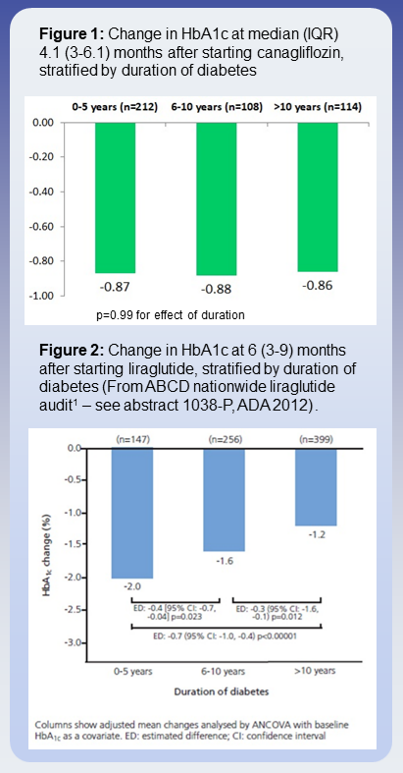
SGLT2 inhibitor audits
Impact of canagliflozin on HbA1c the same regardless of diabetes duration
Compared with findings from liraglutide audit – impact reduces with increasing duration
Presented at ADA 2019

Slide 23

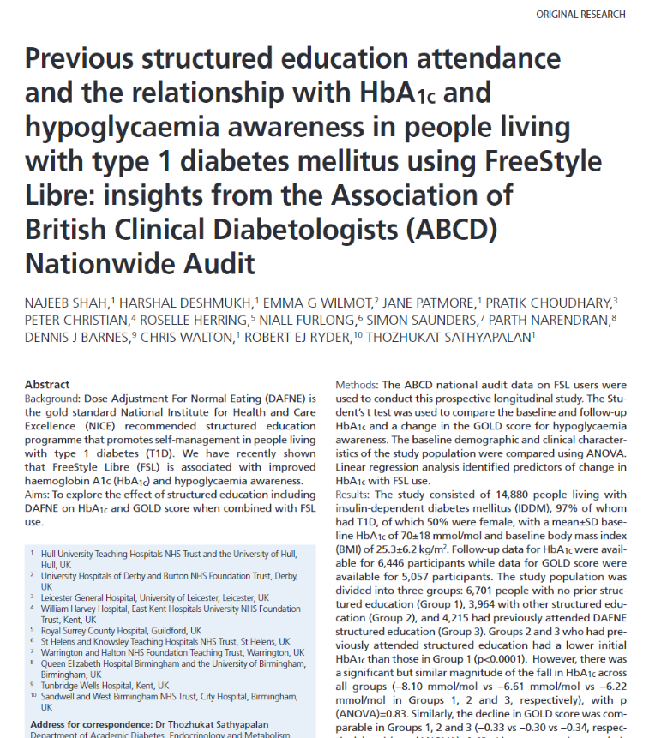
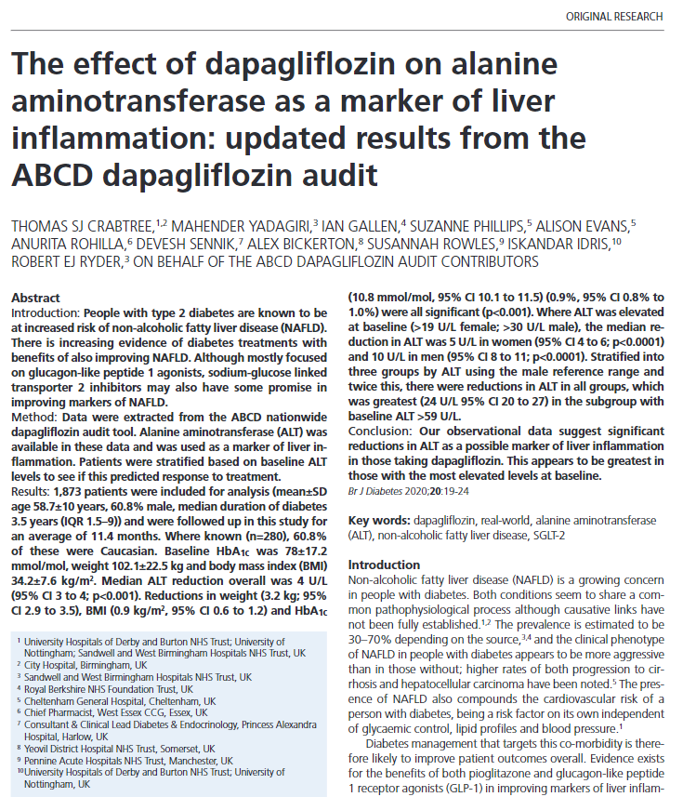
SGLT2 inhibitor audits
Significant reductions in ALT as a possible marker of liver inflammation in those taking dapagliflozin.
This appears to be greatest in those with the most elevated levels at baseline.

Slide 24

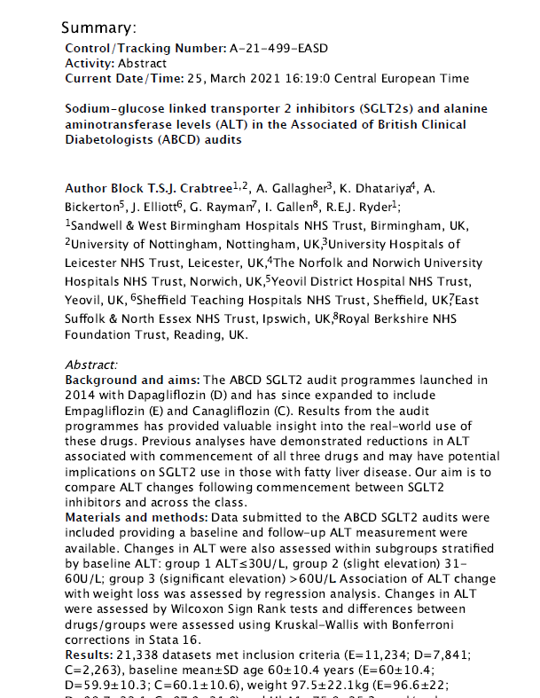
SGLT2 inhibitor audits
SGLT2 inhibitors reduce Alanine Aminotransferase (ALT) across class
Reductions greatest in those with most elevated ALT at baseline

Slide 25
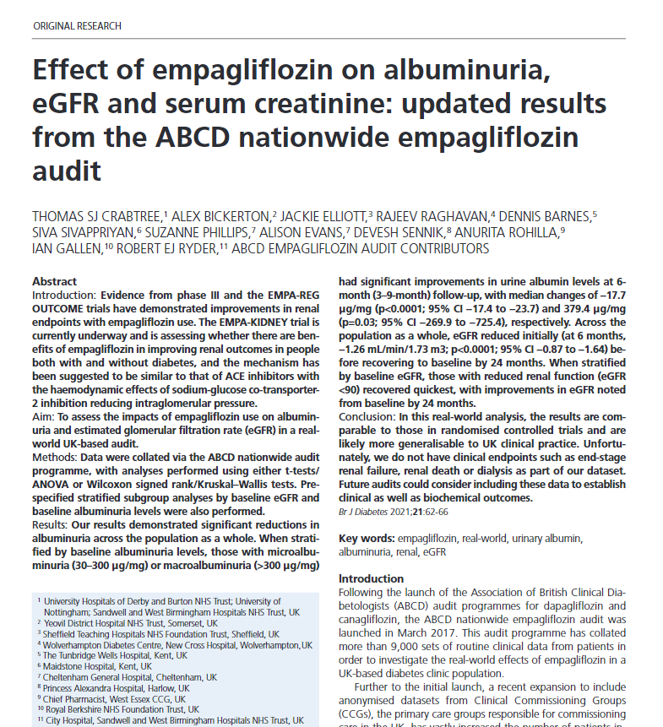
SGLT2 inhibitor audits
Empagliflozin led to significant reductions in albuminuria across the population as a whole
When stratified by baseline albuminuria levels, those with microalbuminuria and macroalbuminuria both had significant improvements in urine albumin levels

Slide 26

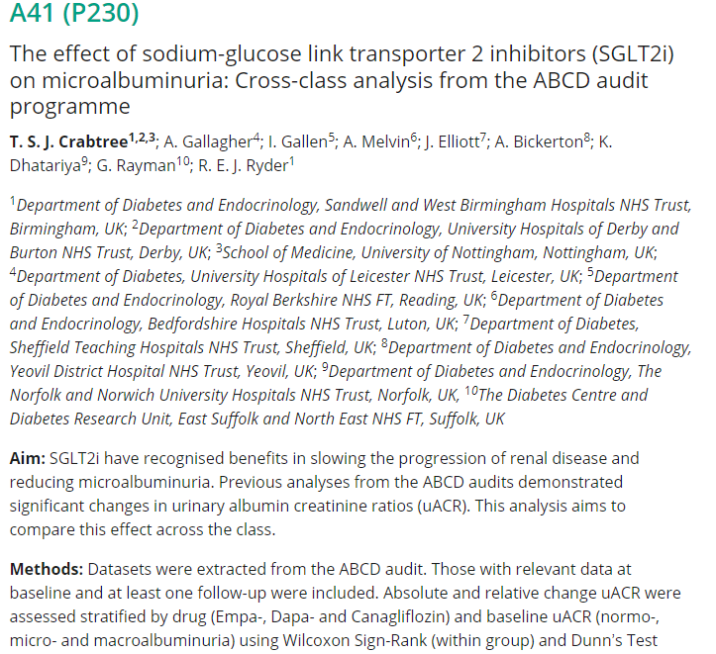
SGLT2 inhibitor audits
All SGLT2i are associated with reductions in uACR at follow-up
These reductions greatest in those with macroalbuminuria at baseline

Slide 27
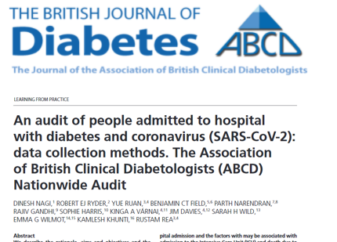
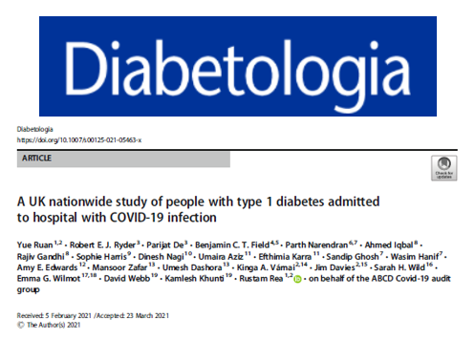
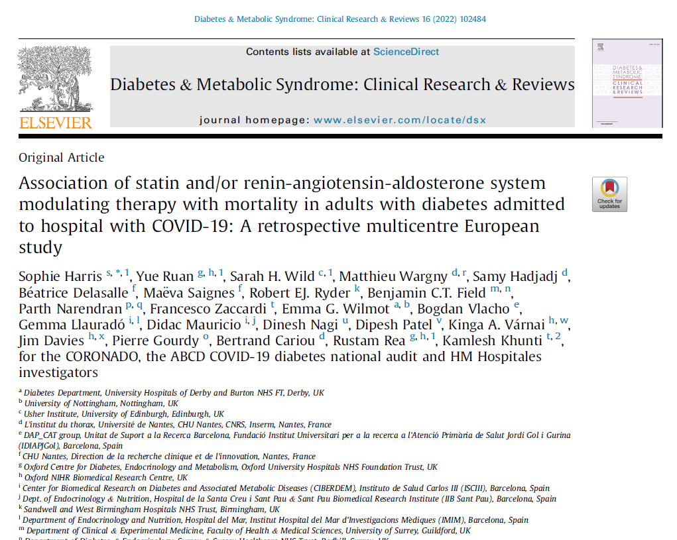
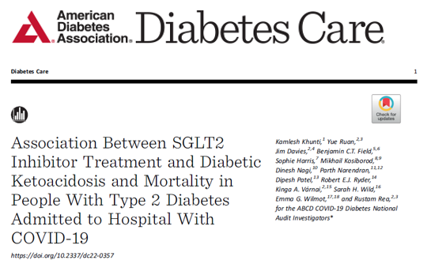
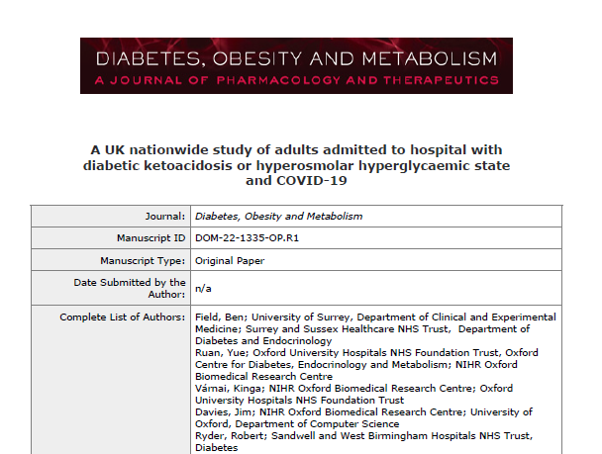
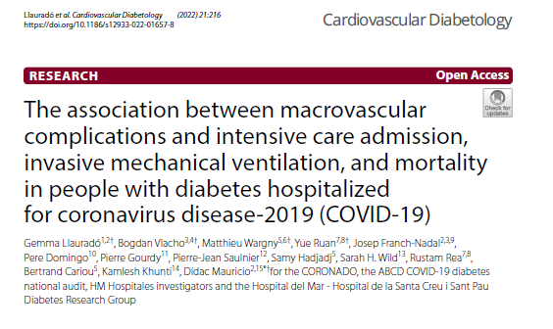
ABCD COVID-19 and Diabetes audit
3542 people with diabetes and COVID admitted to 42 NHS hospitals across the UK
Extended to a collaboration between UK, France and Spain and one between UK, France and New York
10 or 11 published papers!

Slide 28
ABCD COVID-19 and Diabetes audit
Risk of severe COVID-19 is reassuringly very low in people with type 1 diabetes who are under 55 years of age without microvascular or macrovascular disease
No evidence of increased risk of DKA or hospital mortality associated with prescription of SGLT2 inhibitors
Microvascular burden is associated with an increased risk of death in patients hospitalized for COVID-19
Hospitalisation with COVID-19 and adjudicated DKA is four times more common than HHS but both associate with substantial mortality
In people with diabetes mellitus hospitalized for COVID-19 previous macrovascular disease is associated with higher mortality

Slide 29
TESTOSTERONE DEFICIENCY IN MEN WITH TYPE 2 DIABETES
High prevalence - 40% of men with type 2 diabetes have symptomatic testosterone deficiency
Asking about erectile dysfunction should be part of routine annual review in all men with diabetes
Testosterone replacement has been shown to:
  Improve insulin resistance
  Lower HbA1c
  Lower cholesterol
  Reduce body weight
  Reduce mortality

Slide 30
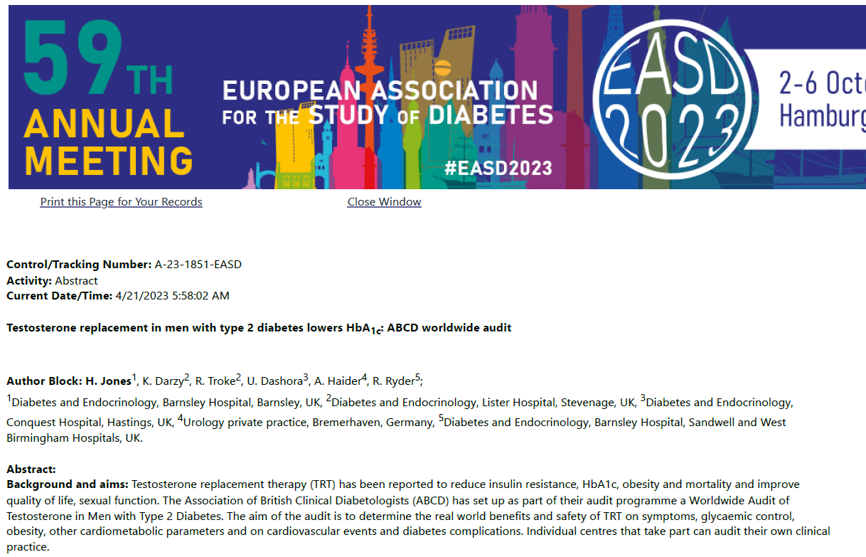
ABCD worldwide audit of Testosterone and Diabetes
From mean baseline HBA1c of 71 mmol/mol HbA1c fell by:
  5 mmol/mol by 3 months
  10 mmol/mol by 12 months
  15 mmol/mol by 24 months
The fact that HbA1c continues to decrease over time is likely to be due to the ongoing effect of testosterone on fat reduction
NB see ePoster P361 for results of an RCT – The Stride Study

Slide 31

ABCD EndoBarrier worldwide registry
Fluoropolymer
wall
Nitinol Anchor
60 cm impermeable sleeve
Minimally invasive

Slide 32
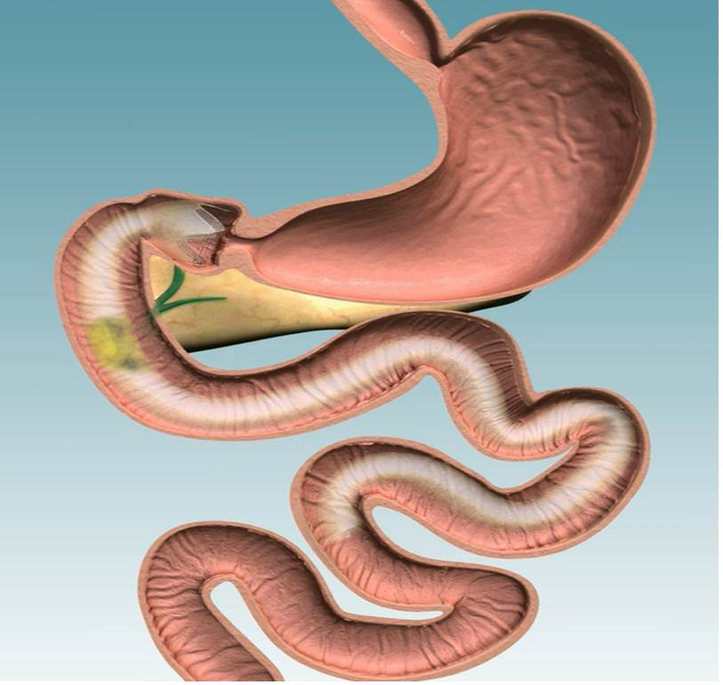
ABCD EndoBarrier worldwide registry
Fluoropolymer
wall
Nitinol Anchor
60 cm impermeable sleeve
Minimally invasive

Slide 33
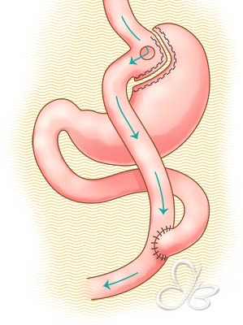
ABCD EndoBarrier worldwide registry
Fluoropolymer
wall
Nitinol Anchor
60 cm impermeable sleeve
Minimally invasive
Roux-en-Y gastric bypass surgery

Slide 34
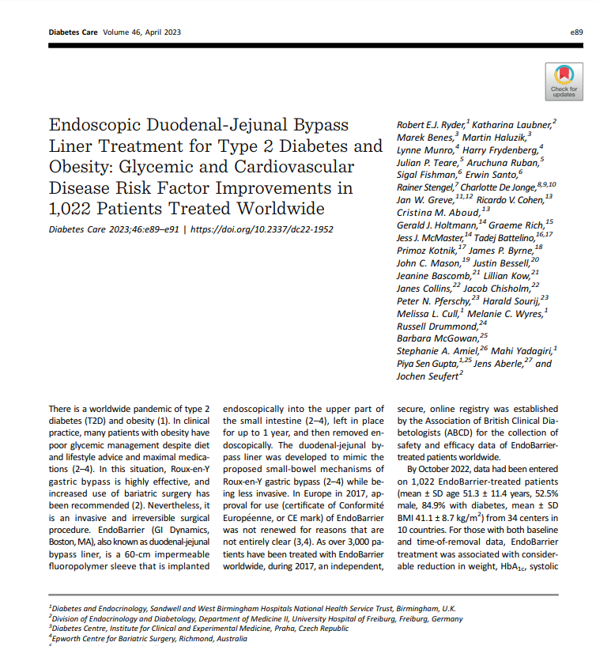
ABCD EndoBarrier worldwide registry
Registry data published in current issue of Diabetes Care (April 2023)

Slide 35
ABCD EndoBarrier worldwide registry
Baseline characteristics
Parameter | n=1022
Age (years) | 51.3±11.2
Sex (% male) | 52.5
BMI (kg/m²) | 41.1±8.7
Diabetes (%) | 84.9

Slide 36
ABCD EndoBarrier worldwide registry
Baseline characteristics
Parameter | n=1022
Age (years) | 51.3±11.2
Sex (% male) | 52.5
BMI (kg/m²) | 41.1±8.7
Diabetes (%) | 84.9

Slide 37
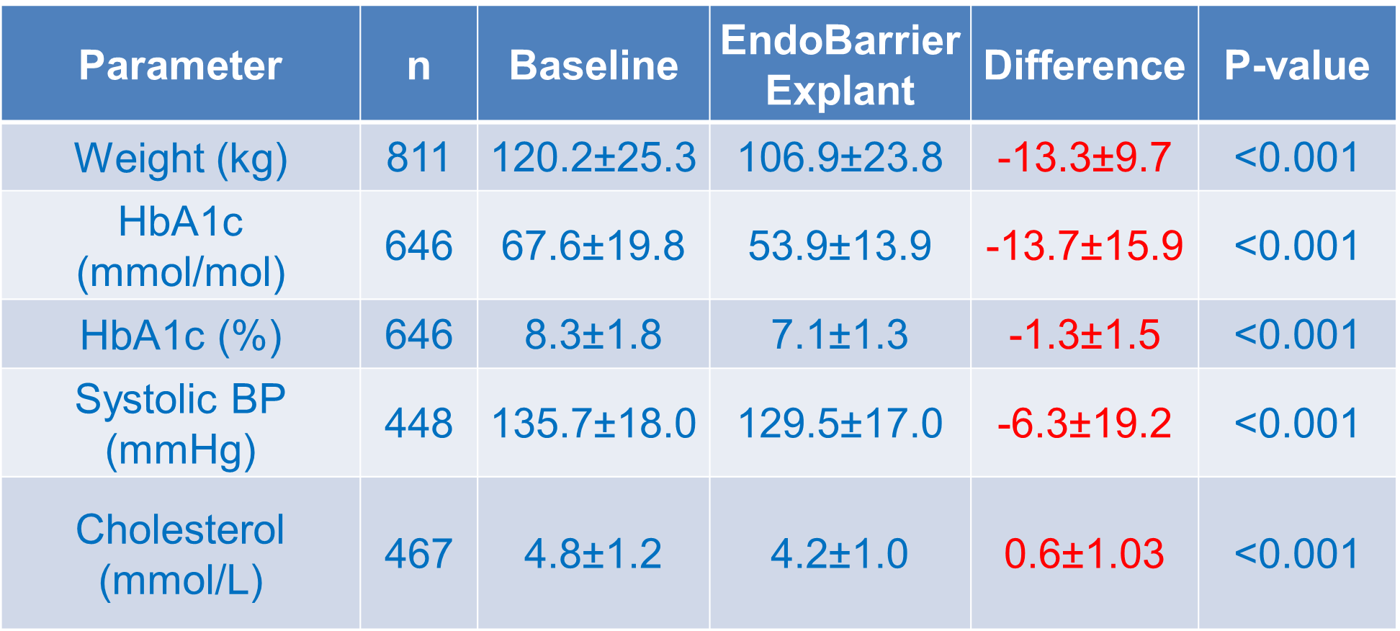
ABCD EndoBarrier worldwide registry
Impact of EndoBarrier

Slide 38
ABCD EndoBarrier worldwide registry
Baseline characteristics
Parameter | n=1022
Age (years) | 51.3±11.2
Sex (% male) | 52.5
BMI (kg/m²) | 41.1±8.7
Diabetes (%) | 84.9

Slide 39
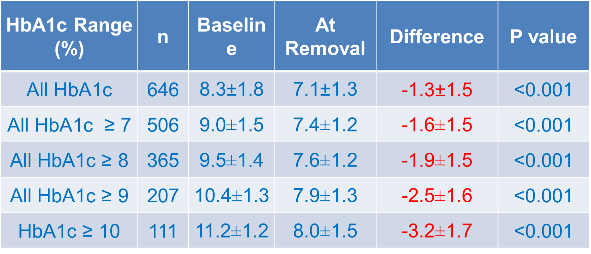
ABCD EndoBarrier worldwide registry
HbA1c response according to baseline HbA1c
NB see ePoster P257 for the latest on EndoBarrier

Slide 40

Please help with these audits:
Testosterone deficiency in men with type 2 diabetes
Oral semaglutide

Slide 41
Dr Mahi Yadagiri
ABCD Research Fellow
Dr Harshal Deshmukh
ABCD Research Fellow
Dr Tom Crabtree
ABCD Research Fellow
Dr Piya Sen Gupta
ABCD Research Fellow
Dr Ken Thong
ABCD Research Fellow
ABCD Nationwide and Worldwide Audits – Research Fellows
Notes:
Melissa – database administrator

Slide 42
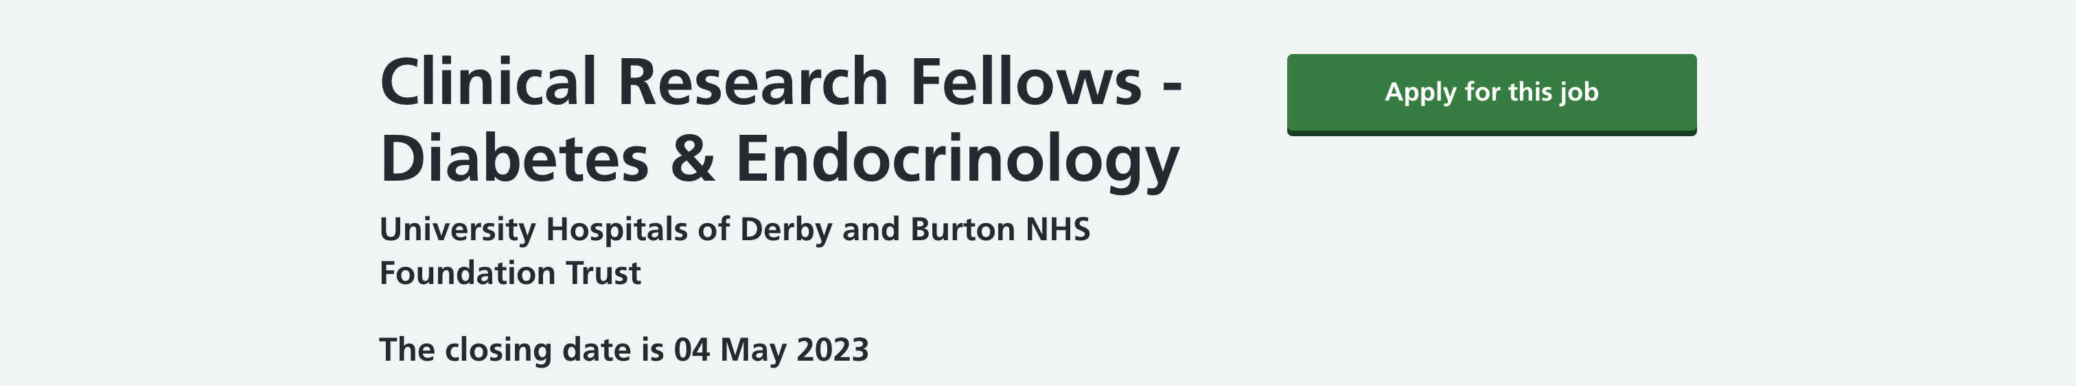
Dr Mahi Yadagiri
ABCD Research Fellow
We currently have 2 funded PhD posts for ABCD research fellows, based in Derby (with visits to Birmingham as required)
If interested, please contact us for more information:
  emma.wilmot2@nhs.net
  bob.ryder@nhs.net
Dr Harshal Deshmukh
ABCD Research Fellow
Dr Tom Crabtree
ABCD Research Fellow
Dr Piya Sen Gupta
ABCD Research Fellow
Dr Ken Thong
ABCD Research Fellow
ABCD Nationwide and Worldwide Audits – Research Fellows
Notes:
Melissa – database administrator

Slide 43

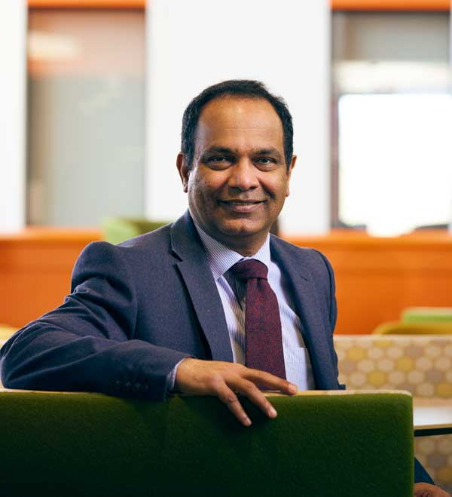
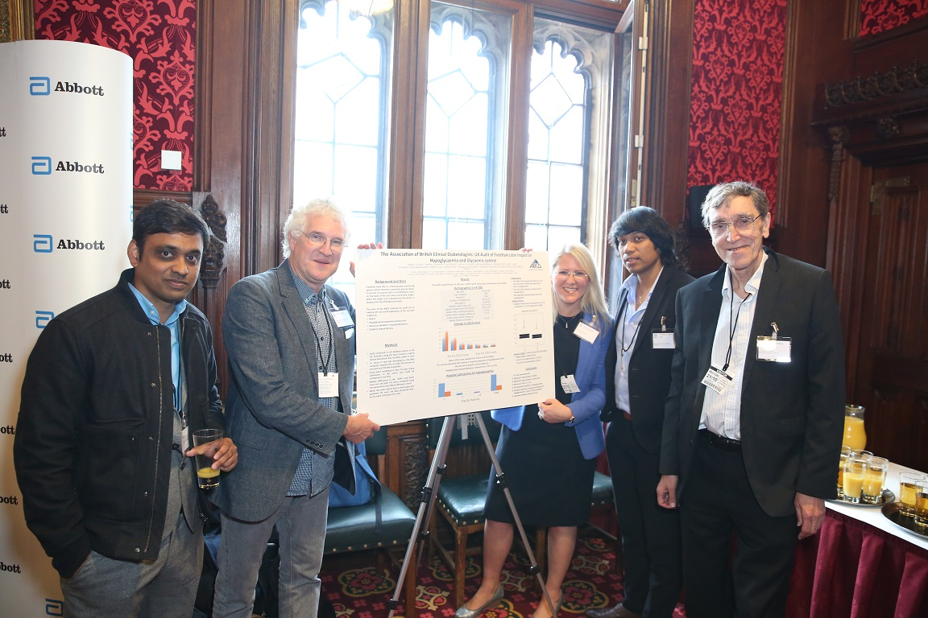
ABCD FreeStyle Libre Audit
Launched in November 2017
Currently has data from >16K FSL users from 107 hospitals in the UK

Slide 44
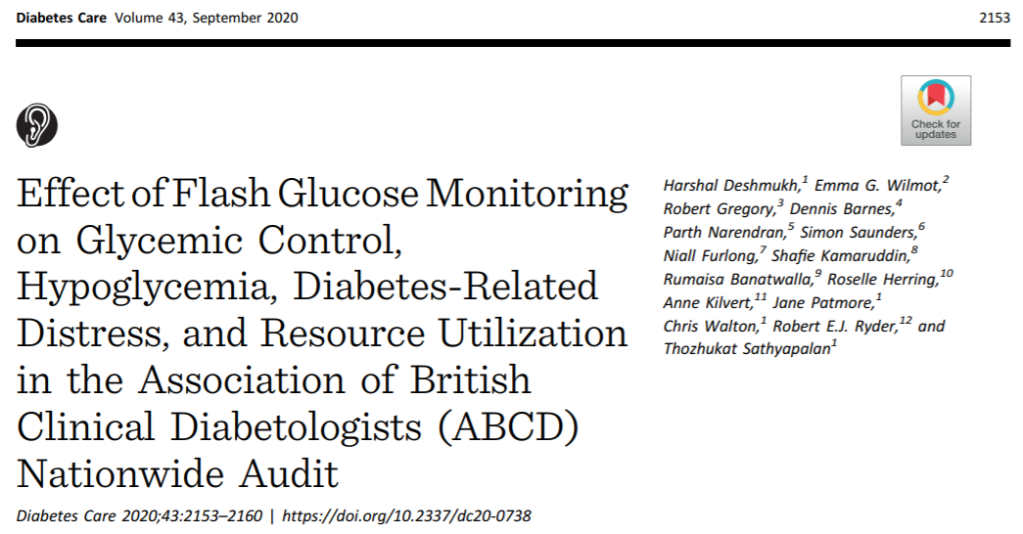
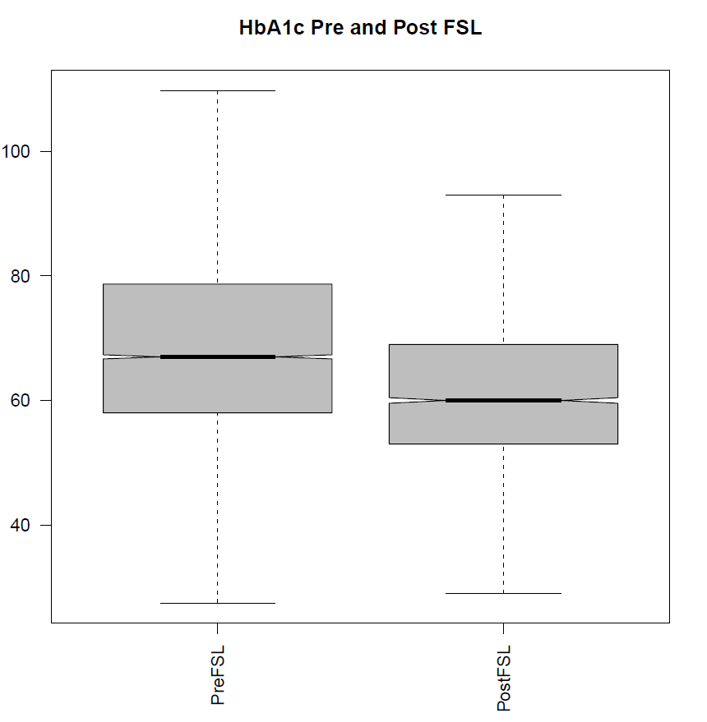
ABCD national audit
Pre-FSL HbA1c (IQR) | 68 (18)
Post FSL HbA1c (IQR) | 62 (17)
P-value* | <0.0001
5.2 mmol/mol HbA1c
The use of FSL was also associated with improvements in
Gold score
Paramedic callouts
Hospital admissions
N=3182
*P-value from Mann-Whitney U Test
Deshmukh H, Wilmot EG et al. Diabetes Care 2020 15;43(9):2153-60

Slide 45

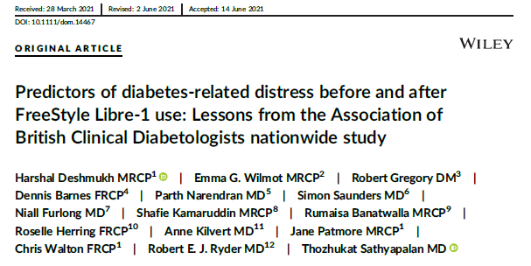
ABCD nationwide audit of FreeStyle Libre
9159 FSL users
53% had diabetes related distress
FSL use was associated with improvement in diabetes-related distress

Slide 46
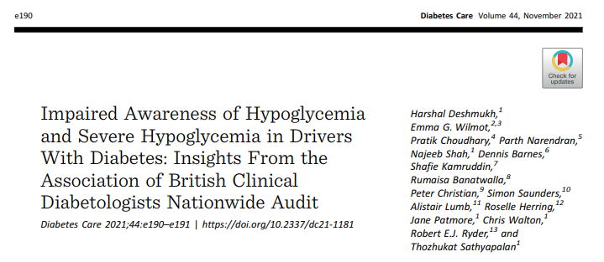

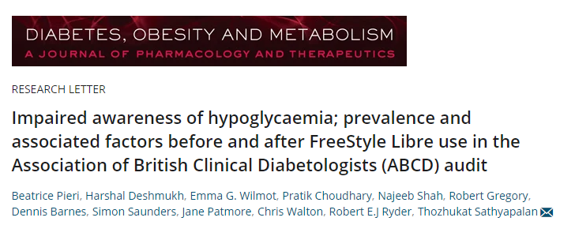
ABCD nationwide audit of FreeStyle Libre
1 in 5 drivers with T1DM had impaired awareness of hypoglycaemia (IAH)
IAH was associated with
  increasing age
  a longer duration of diabetes
Just over half of the people with IAH had restoration of awareness after FSL use

Slide 47
ABCD nationwide audit of FreeStyle Libre
Those who had completed structured education before FSL initiation had lower HbA1c values vs. those who had not
However, the subsequent change in HbA1c associated with FSL use did not differ between the 2 groups

Slide 48
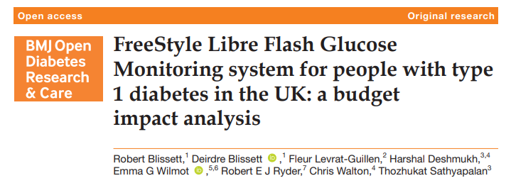
ABCD nationwide audit of FreeStyle Libre
FreeStyle Libre reduces diabetes-related resource utilization
Cost analysis found that higher acquisition costs are offset by healthcare costs avoided – difference of £168 per patient per year

Slide 49
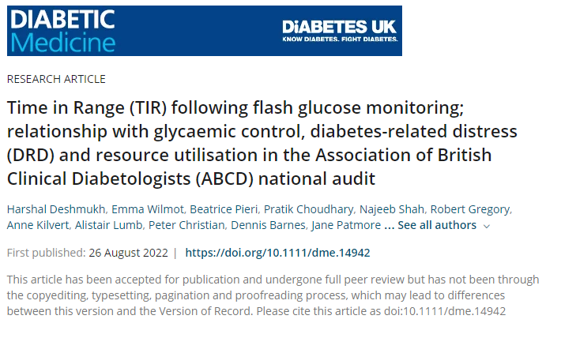
ABCD nationwide audit of FreeStyle Libre
Higher Time-In-Range associated with improvement in:
  HbA1c
  Hypoglycaemia awareness
  Diabetes Related Distress
  Resource utilisation

Slide 50
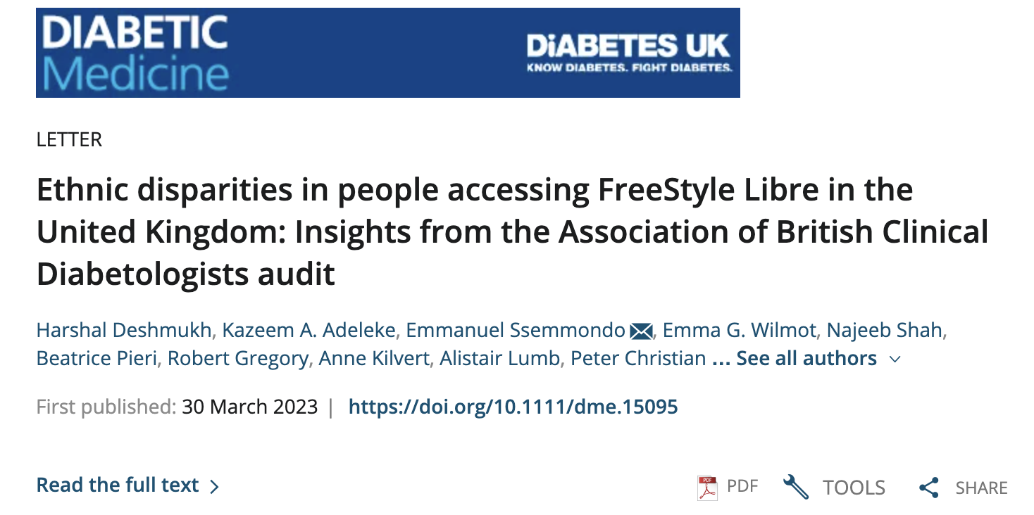
ABCD nationwide audit of FreeStyle Libre
The Afro-Caribbean FSL user population had
  higher HbA1c
  shorter duration of diabetes
  higher prevalence of diabetes related distress
Afro-Caribbeans and Bangladesh, Indian and Pakistani (BIP) groups were more likely to have completed structured education prior to FSL initiation

Slide 51
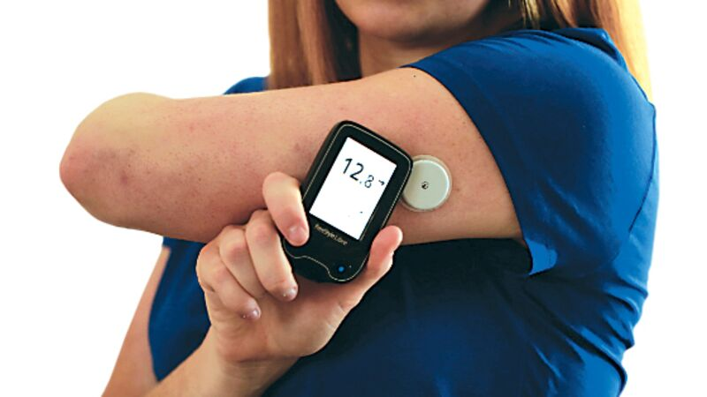
Glucose Monitoring Audit 2023: focus on T2DM
NICE 2022 recommends wider access to flash glucose monitoring for people with T2DM
ABCD FreeStyle Libre Audit is an opportunity to capture and feedback outcomes
ABCD Dexcom rtCGM Audit coming soon
Some ICS have incorporated mandatory audit
Sign up for at the ABCD website https://abcd.care/abcd-nationwide-audits

Slide 52



ABCD DIY-Artificial Pancreas Systems audit
Abstracts presented at ATTD 2022, Barcelona:
101 DIY-APS users
Use associated with clinically significant improvements in HbA1c
Most achieve optimal time-in-range and time-below-range
No significant change in the number of hospital admissions/paramedic callouts

Slide 53



ABCD DTN-UK
Hybrid Closed Loop Audit

Slide 54


ABCD-DTN closed-loop insulin delivery audit
Methodology
NHS England pilot programme
T1DM, using pump therapy & FreeStyle Libre with HbA1c ≥ 69mmol/mol

Slide 55

Dr Tom Crabtree
will be presenting the full results on Friday at 1455
– don’t miss it!

Slide 56

ABCD DTN-UK Omnipod DASH audit
Pre-Omnipod DASH Baseline Results N = 144
HbA1c | 8.3% [66.8 mmol/mol]
Age | 36 yrs
New pump users | 32.6%
Indications for pump therapy | Problematic hypoglycaemia: 34.3% HbA1c > target: 27.6%
CGM use | 77.8%
Median index of multiple deprivations | 8 (more non-deprived users)
Omnipod DASH® audit – 2022 start
Providing insights into who is using device and their outcomes
Omnipod DASH® ABCD Audit outcome data
presented by Dr Nebras Hasan on Friday at 12.15pm
Don’t miss it!

Slide 57

ABCD Fellow Opportunities!
Two successful ABCD research fellows:
  Dr Tom Crabtree
  Dr Harshal Deshmukh
We currently have 2 funded PhD posts for ABCD research fellows, based in Derby (with visits to Birmingham as required)
If interested please contact us for more information:
  emma.wilmot2@nhs.net
  bob.ryder@nhs.net

Slide 58
Conclusion
ABCD audit programme is a highly successful collaboration of Diabetologists
Provides insight into the real-world outcomes related to a range of therapies and devices
Data is presented at key national and international meetings
Outcomes published in high impact journals
A great opportunity for trainees to perform audit and service evaluation
Thank you to all who have contributed!

Slide 59













Thank you to all the audit contributors!
ABCD nationwide & worldwide audit contributors The following are those whom we know about.
ABCD nationwide & Worldwide audits – initial setup, maintenance and nationwide analysis: Ryder, REJ, Cull ML.

Slide 60
Thank you to all the audit contributors!
Special thanks to Miss Melissa Cull – ABCD audits administrator
ABCD nationwide & worldwide audit contributors The following are those whom we know about.
ABCD nationwide & Worldwide audits – initial setup, maintenance and nationwide analysis: Ryder, REJ, Cull ML.

